Slide 1
Ingress Overview

Slide 2
Services Recap:
In Kubernetes, a Service is a method for exposing a network application that is running as one or more Pods in your cluster.
It is of three main types:
ClusterIP
NodePort
LoadBalancer

Slide 3
Type 1: ClusterIP
Default service type in Kubernetes.
ClusterIP Services are meant for Pod-to-Pod communication only. They aren't accessible from outside the cluster.

Slide 4
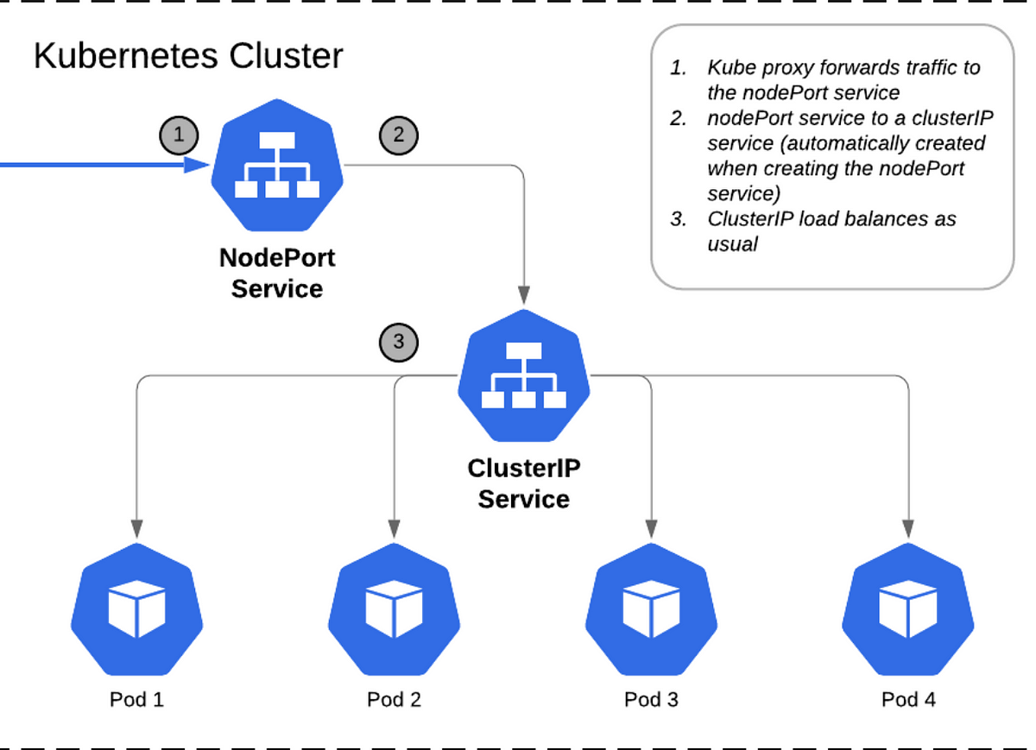

Slide 5
Type 2: NodePort
It is useful when you need to expose your application to external clients. It builds on top of the ClusterIP service.
When you create a NodePort Service, Kubernetes opens a port (in the range of 30000 and 32767) on all of its worker nodes.
All traffic incoming to the worker node's IP address, and that specific port, is redirected to a Pod linked with that Service.

Slide 6
Type 3: LoadBalancer
It is based on the NodePort service and distributes network traffic across multiple instances of an application running in a K8S cluster.
It adds the ability to configure external load balancers in public and private clouds. It exposes services running within the cluster by forwarding network traffic to cluster nodes.
Load balancers in K8S can be implemented by using a cloud provider-specific load balancer such as Azure Load Balancer, AWS Network Load Balancer (NLB), or Elastic Load Balancer (ELB) that operates at the Network Layer 4 of the OSI model.

Slide 7
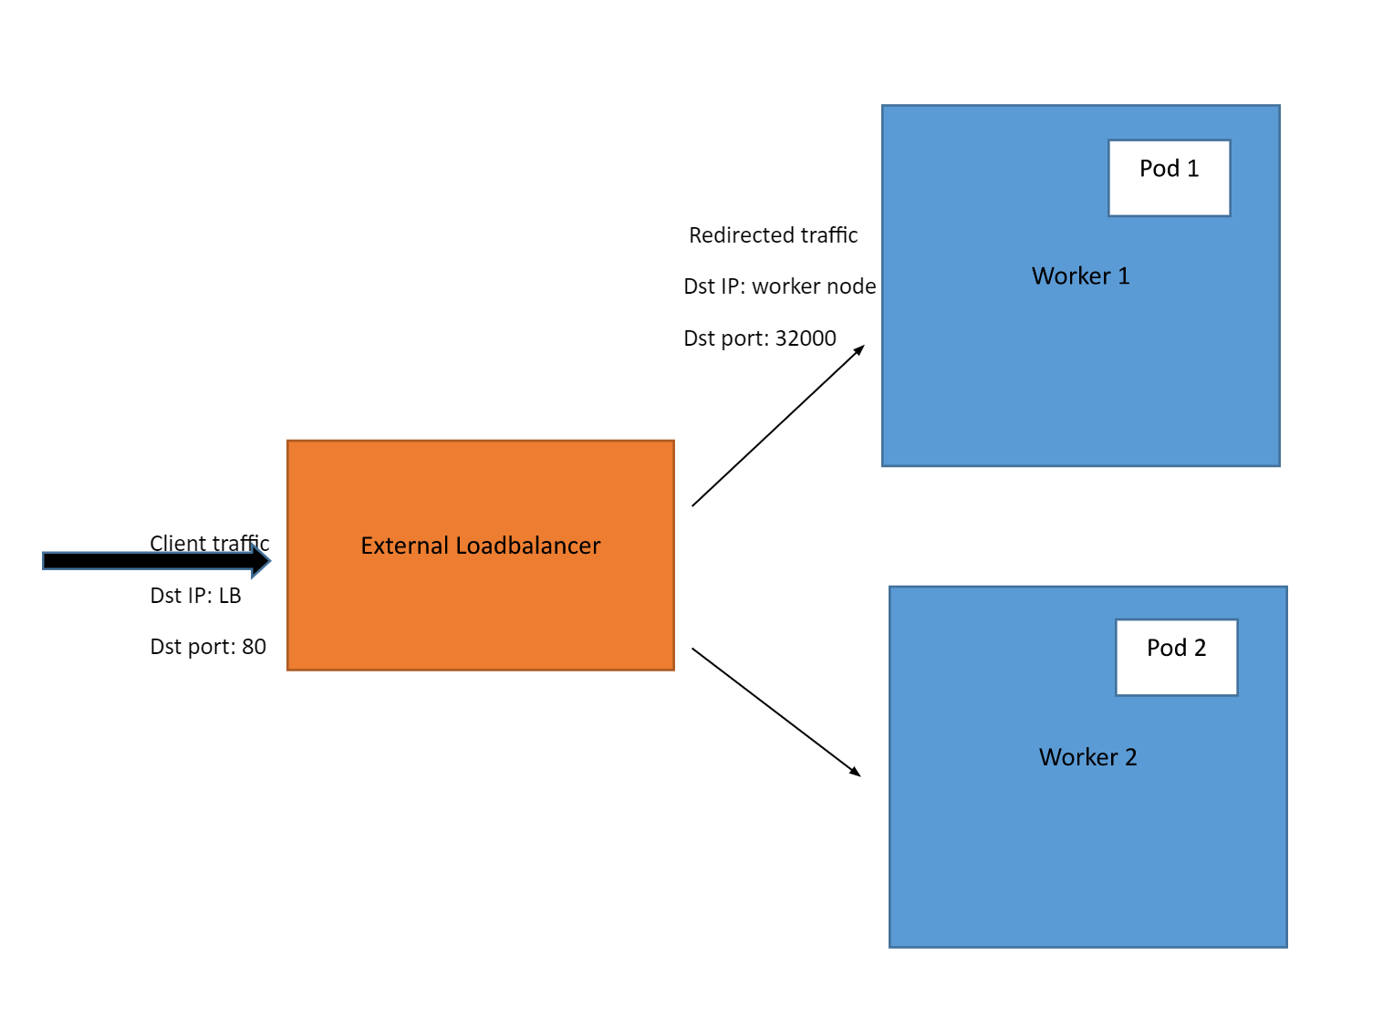

Slide 8
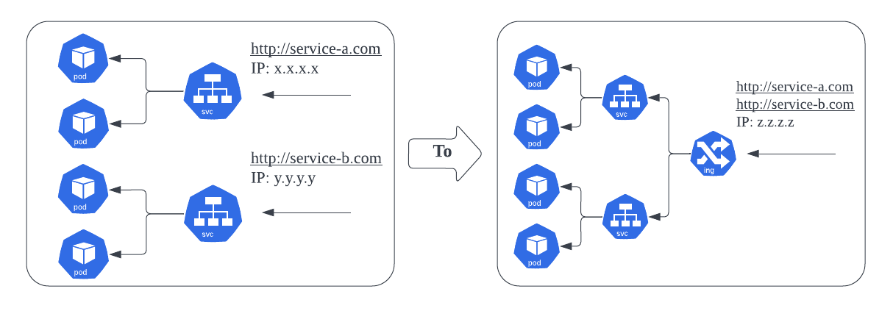
What if there are multiple applications running?

Slide 9
Ingress:
In Kubernetes, an ingress lets us route traffic from outside the cluster to one or more services inside the cluster.
Typically, the ingress works as a single point of entry for all incoming traffic. Then, using a set of rules, it forwards all of its traffic to an appropriate service. In turn, that service will send the request to a pod that can actually handle the request.
Kubernetes Ingress Resource: Kubernetes ingress resource is responsible for storing routing rules in the cluster.
Kubernetes Ingress Controller: Kubernetes ingress controllers (Nginx/HAProxy etc.) are responsible for routing by accessing the DNS rules applied through ingress resources.

Slide 10
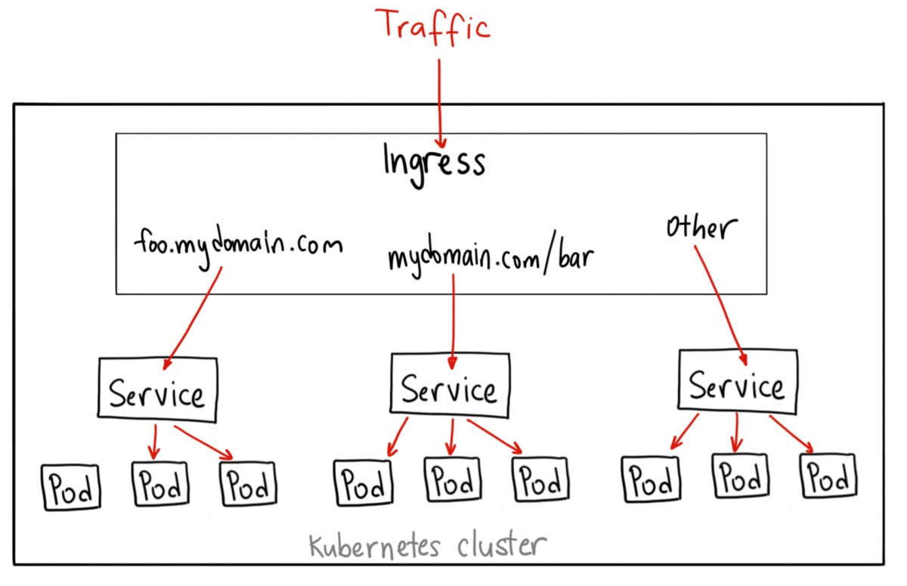

Slide 11
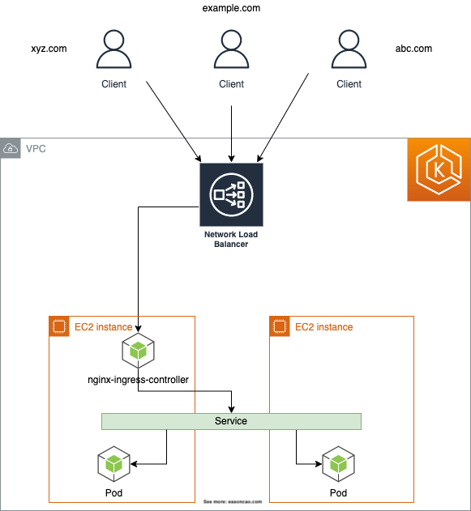
Ingress Controller:
Ingress controller is not a native Kubernetes implementation.
We need to set up an ingress controller for the ingress rules to work. There are several open-source and enterprise ingress controllers available.
Nginx is one of the widely used ingress controllers.

Slide 12
NGINX Ingress Controller
To use the NGINX Ingress Controller in a Kubernetes cluster, you need to deploy the NGINX Ingress Controller as a deployment in your cluster. You also need to create Ingress resources in your cluster to define the rules for routing traffic to the services.
The NGINX Ingress Controller runs as a pod within a Kubernetes cluster. It watches for changes to the Ingress resources in the cluster and updates its configuration accordingly. The Nginx controller talks to Kubernetes ingress API to check if there is any rule created for traffic routing.
When a client sends a request to the NGINX Ingress Controller, it looks up the Ingress rules configured in the cluster to determine which service to route the request to. The NGINX Ingress Controller then forwards the request to the appropriate service and returns the response to the client.

Slide 13
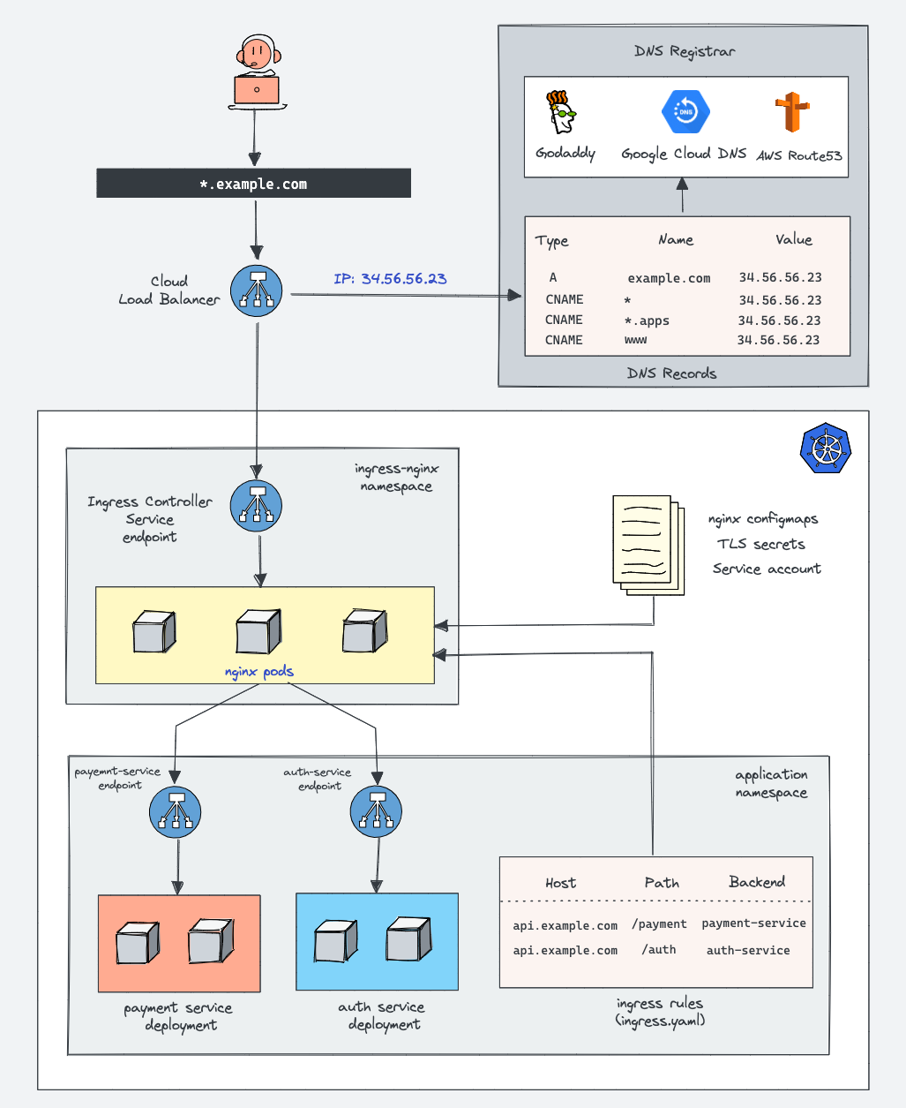
Ingress & Ingress Controller Architecture:

Slide 14
How does NGINX Controller work?
The nginx.conf file inside the Nginx controller pod is a lua template that can talk to Kubernetes ingress API and get the latest values for traffic routing in real-time.
The Nginx controller talks to Kubernetes ingress API to check if there is any rule created for traffic routing.
If it finds any ingress rules, the Nginx controller generates a routing configuration inside /etc/nginx/conf.d location inside each nginx pod.
For each ingress resource you create, Nginx generates a configuration inside /etc/nginx/conf.d location.
The main /etc/nginx/nginx.conf file contains all the configurations from etc/nginx/conf.d.
If you update the ingress object with new configurations, the Nginx config gets updated again and does a graceful reload of the configuration.

Slide 15
Components of NGINX Ingress Controller Manifest:
To have a working Nginx controller, we need to deploy the following Kubernetes objects :
ingress-nginx namespace
Service account/Roles/ClusterRoles for Nginx admission controller
Validating webhook Configuration
Jobs to create/update Webhook CA bundles
Service account/Roles/ClusterRoles of Nginx controller deployment
Nginx controller configmap
Services for nginx controller & admission controller
Ingress controller deployment

Slide 16
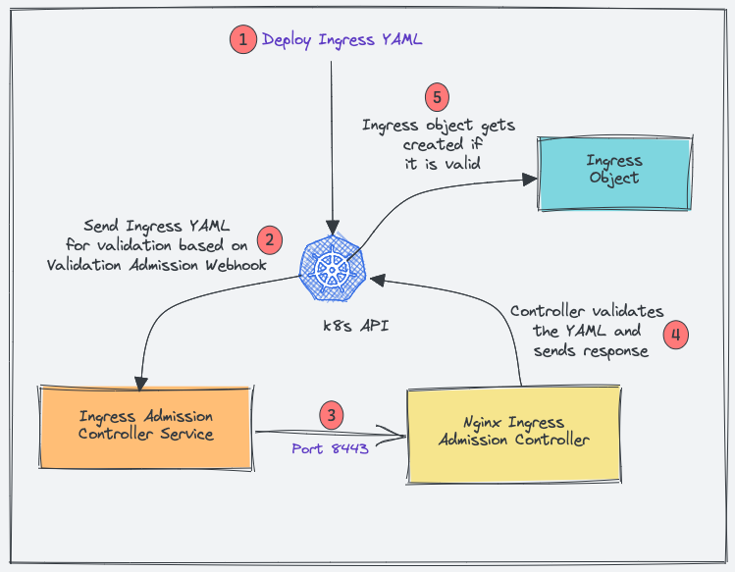
NGINX Admission Controller:
Admission Controller ensures that the ingress object you create has the correct configurations and doesn’t break routing rules
When you deploy an ingress YAML, the Validation admission intercepts the request.
Kubernetes API then sends the ingress object to the validation admission controller service endpoint based on admission webhook endpoints.
Service sends the request to the Nginx deployment on port 8443 for validating the ingress object.
The admission controller then sends a response to the k8s API.
If it is a valid response, the API will create the ingress object.

Slide 17
More components:
ValidatingWebhookConfiguration: This validates the API object and accepts or rejects it. In this case it will send the object after validation to Admission Controller Service endpoint which will forward it via 8443 to Admission Controller for validation. The ValidatingWebhookConfiguration works only over HTTPS. So it needs a CA bundle.
Jobs: There are two jobs in the controller manifest. One creates a CA bundle for WebhookValidation and the other binds the bundle to the WebhookValidation.
ServiceAccounts: They are created for Admission Controller and Controller Deployment. Roles and clusterRoles are mapped to them using Role and clusterRoleBinding.
ConfigMaps: With this configmap, you can customize the Nginx settings. For example, you can set custom headers and most of the Nginx settings.
IngressClass: This is created and later used in Ingress Resource. This helps the controller read the Ingress rules.

Slide 18
Thank You!

